Slide 1
Machine Learning Applications to Semiconductor Manufacturing Process Control
Enzo Borja
NYCDSA Capstone Project
January x, 2021
code: https://github.com/lorenzom21/capstone
Online article:

Slide 2
Overview
Introduction to Semiconductor Process | Module-level decisions based on Random Forest modelling | Product uniformity improvement using K-means clustering
Two main problems addressed here:
Improving factory yield.
Reducing product variability.

Slide 3
Semiconductor process
deposition
lithography
etch
putting down material
"writing" the pattern"
etching the material based on pattern
Other steps:
cleans, planarization, measurements, baking, testing
These steps repeat for multiple layers.
Products are chips
i.e. CPU, GPU, LED’s

Slide 4
Traditional process control
Design target
Quantify variability
Set limits
If process exceeds limits, action required.
Example: deposition of a 500nm metal film
500 nm metal
silicon substrate
495 nm
500 nm
505 nm
We run a start-up experiment and we find that the film thickness of several lots is: 500 nm mean. 5nm standard deviation. If we choose 1 standard deviation as the limit, then the limits will be 495 to 505 nm.

Slide 5
Problems with traditional process control
Hundreds of parameters. | These parameters interact. High values in one parameter can offset low values in a different parameter.

Slide 6
Use Random Forest for improving yield
Data: UCI SECOM Dataset
https://www.kaggle.com/paresh2047/uci-semcom#uci-secom.csv
538 factory parameters, and a pass/fail column
52 columns omitted for having >15% n/a
Random Forest Parameters
92% test score
100 trees used

Slide 7
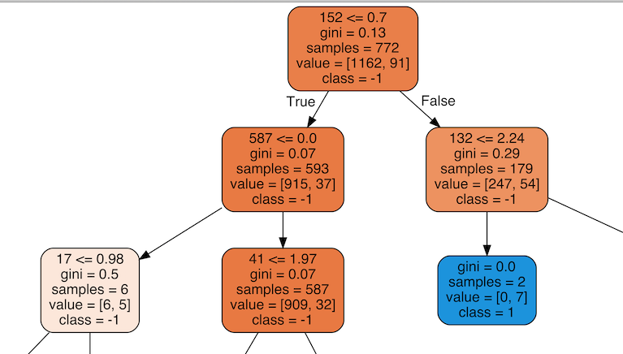
Visualization of one tree
If you are controlling parameter 152, do you want it less than or greater than 0.7? Following options:
Controllability: Decide based on what has simpler branching down stream.
Best chances: Decide based on which has the highest probability of success.

Slide 8
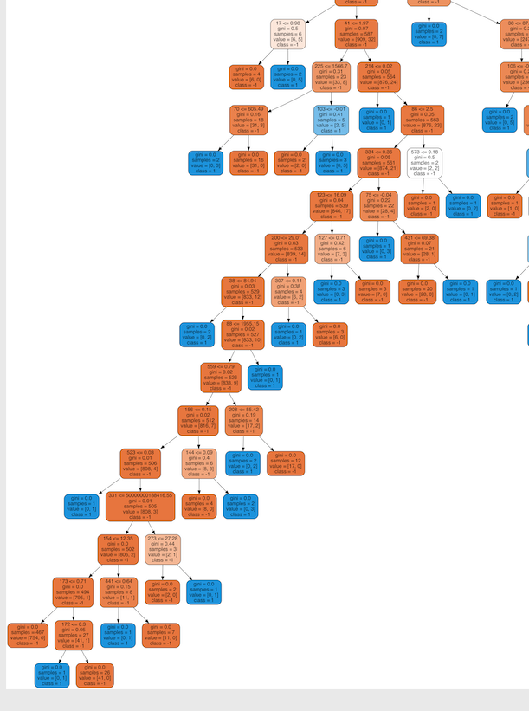
Prioritizing controllability
If you were this guy, which path would you take?
simple
Complicated

Slide 9
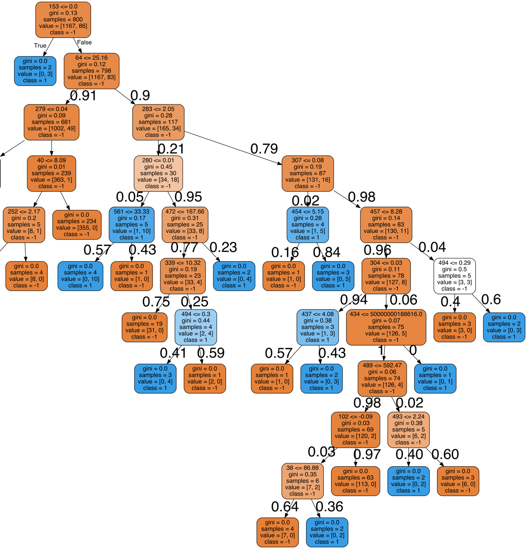
How can this influence what values to control for?
module making decision
Assume we are the module controlling parameter 283.
Do we keep it above or below 2.05?
outcome | chance of passing
below | 84.9%
above | 45%
0.029
0.024
0.046
0.046
0.017
0.55
0.016
0.024
This parameter is already 79% likely to be >2.05, which is not favorable!
These was done by:
Calculate the probabilities at each split based on the distribution of data at that node.
Multiply all the probabilities leading to an endpoint to get the probability of that endpoint.
Sum all the probabilities of the passing outcomes for below and above.
0.076
0.110
0.51
0.51
0
if param 283 <=2.05
0.054
0.005
0.005
0.001
0.0006
if param 283 > 2.05

Slide 10
Challenge for Implementing Random Forest
This is just 1 tree. How to aggregate predictions of all 100 trees?
Brute force method: do analysis shown before for each tree, and take average. This is can be computationally expensive, or a very painful manual process.

Slide 11
Using K-means clustering to improve product variability
Tried clustering for 1 to 9 clusters. Elbow is between 2 and 3. Used 2 for further analysis.
Are the 2 clusters based on on pass/fail?

Slide 12
Using K-means clustering to improve product variability
No!
We must find and eliminate difference between these two clusters. A good process has no clustering.
Cluster | Passing rate | N
0 | 92.8% | 1,245
1 | 93.5% | 322

Slide 13
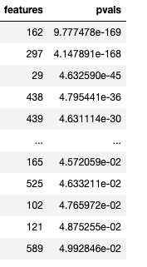
Finding the difference between clusters
100 parameters with p-value < 0.05
Use Kruskal test to compare parameters between two clusters. This test is similar to ANOVA or t-test but can tolerate difference in size of the two samples.
Rank parameters based on the biggest difference (i.e. smallest p-values.)

Slide 14
Finding the difference between clusters
Biggest mismatch was parameter 162. A factory manager would prioritize understanding and controlling this mis match.

Slide 15
Conclusion
These methods can improve yield and product variability. Key things to look into are:
Aggregating results from multiple trees in a random forest model.
Translating random forest predictions to actual decisions based on controllability and complexity.
Understanding cluster difference beyond just a single parameter.

